Slide 1
Introduction to data warehousing
MTN.BI.07
Oracle Database Architecture
Elias Nema
Lead Software Engineer
Elias_Nema@epam.com

Slide 2
Agenda
Databases and Instances
Logical Components
Physical Components
Instance Memory and Processes
Connecting to Oracle
SQL Execution

Slide 3
Databases and Instances

Slide 4
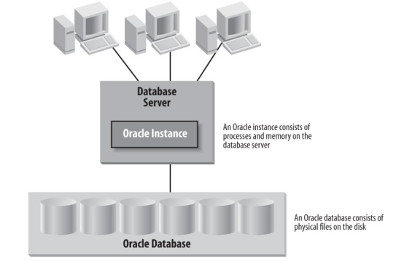
What Database really is: Instance vs. Database
Notes:
In Oracle, the term database refers to the physical storage of information, and the term instance refers to the software executing on the server that provides access to the information in the database and the resources that software uses. The instance runs on the computer or server; the database is stored on the disks attached to the server.

Slide 5
LOGICAL components

Slide 6
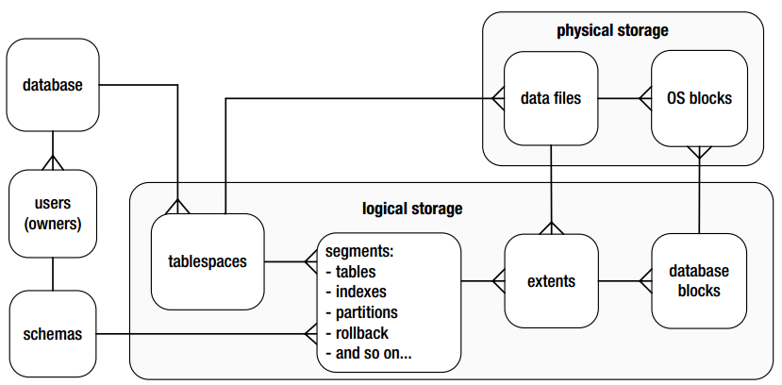
Relationships of logical and physical storage
Notes:
All of the data stored within an Oracle Database must reside in a tablespace. A tablespace is a logical structure; you can’t look at the operating system and see a tablespace. Each tablespace is composed of physical structures called datafiles; each tablespace must consist of one or more datafiles, and each datafile can belong to only one tablespace. When creating a table, you can specify the tablespace in which to create it.

Slide 7
Physical components

Slide 8
Physical components
Three principal database file types are:
Data files: These are for the database; they hold your tables, indexes, and all other data segment types.
Control files: These tell you where the data files, temp files, and redo log files are, as well as other relevant metadata about their state. They also contain backup information maintained by RMAN (Recovery Manager, the backup and recovery tool).
Redo log files: These are your transaction logs.

Slide 9
The files that makes up a database

Slide 10
Control Files
Every Oracle Database has a control file, which is a small binary file that records the physical structure of the database. The control file includes:
The database name
Names and locations of associated datafiles and redo log files
The timestamp of the database creation
The current log sequence number
Checkpoint information and other information

Slide 11
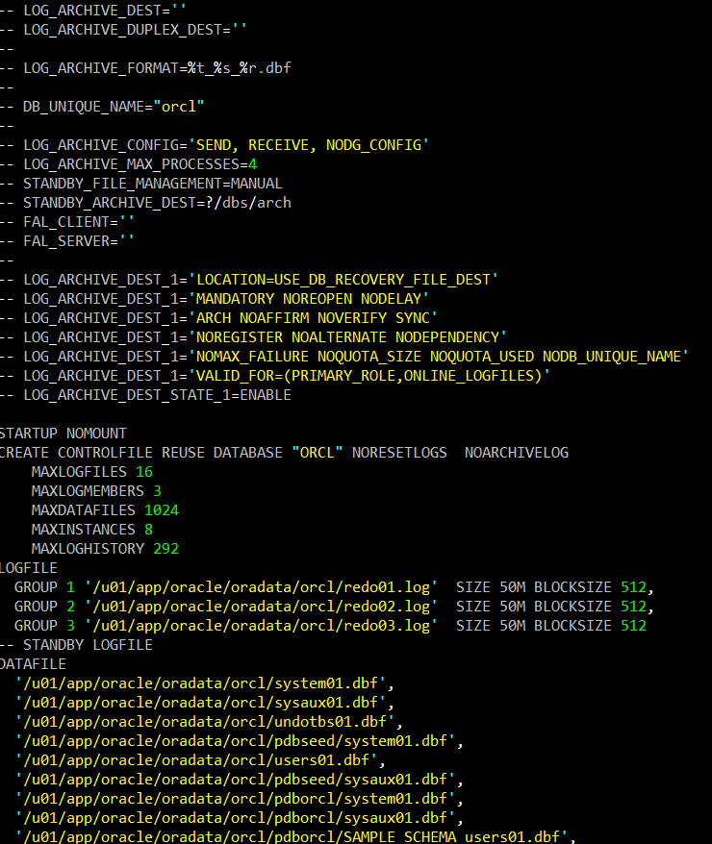
Sample Controlfile
SELECT * FROM v$controlfile;
SELECT * FROM v$controlfile_record_ section;
ALTER DATABASE BACKUP CONTROLFILE TO TRACE as '/share/ctrl_file.txt';

Slide 12
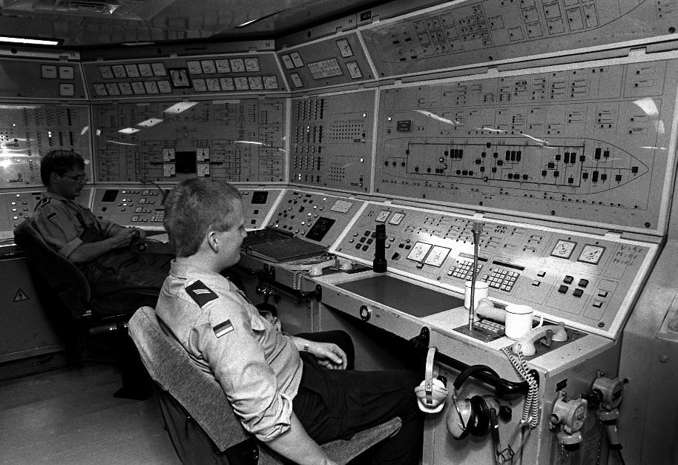
Control Files
It must be available for writing whenever the database is open. Without the control file, the database cannot be mounted and recovery is difficult.
The control file is created at the same time as the database. You should create two or more copies of the control file.

Slide 13

Datafiles
Datafiles contain the actual data stored in the database, the tables and indexes that store data, the data dictionary that maintains information about these data structures, and the rollback segments used to implement multiuser concurrency.
A datafile is composed of Oracle Database blocks that, in turn, are composed of operating system blocks on a disk. Oracle block sizes range from 2 KB to 32 KB.

Slide 14
Datafile Structure
The first block of each datafile is called the datafile header. It contains critical information used to maintain the overall integrity of the database (checkpoint structure - a logical timestamp that indicates the last point at which changes were written to the datafile).
From a physical point of view, a datafile is stored as operating system blocks. From a logical point of view, datafiles have three intermediate organizational levels: data blocks, extents, and segments.
An extent is a set of data blocks that are contiguous within an Oracle datafile.
A segment is an object that takes up space in an Oracle Database, such as a table or an index that is composed of one or more extents.

Slide 15
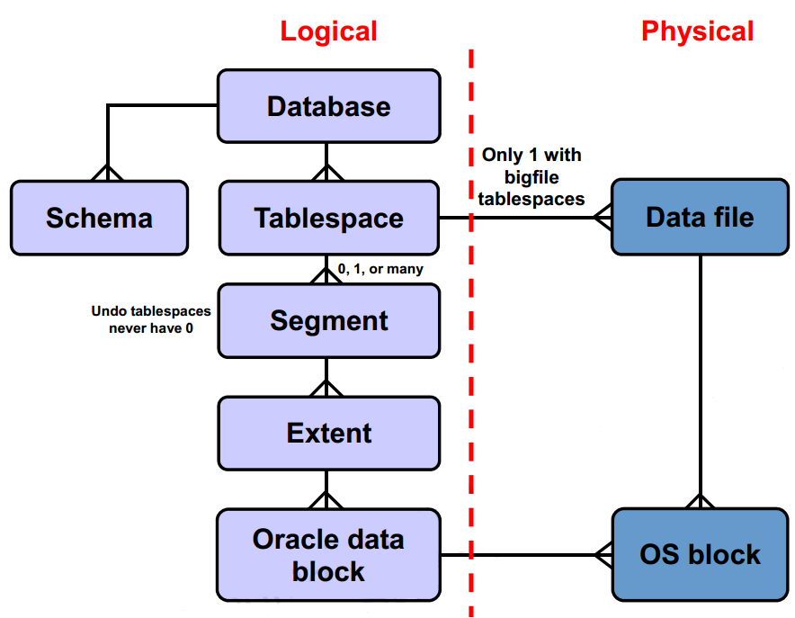
Datafile Hierarchy

Slide 16
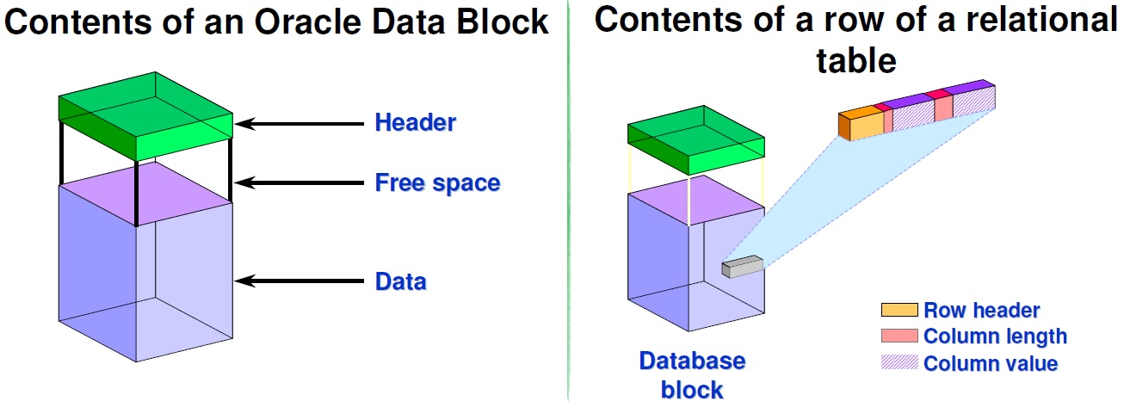
Data Block Content
Each block contains a header, which includes a directory of rows, and it includes the actual data.
Each row of a table is stored in the database block. The row storage includes a header and subsequent column length/column data pairs. A row is completely identified by its rowid which consists of database file number (mapped to file name), block number in that file, and row number within the block.

Slide 17
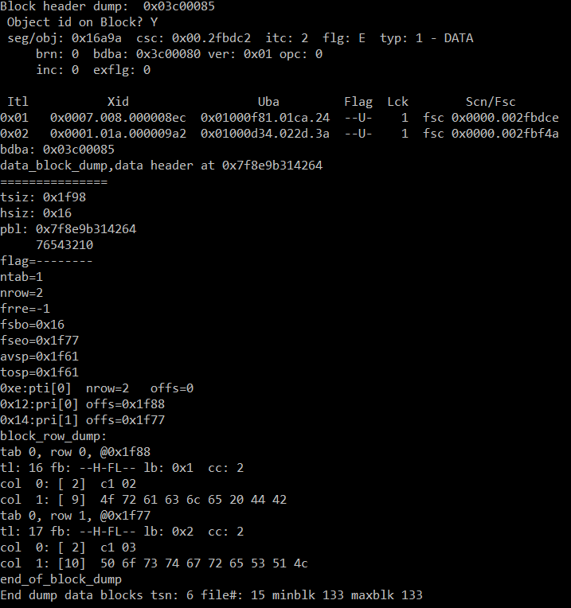
Data Block Sample
select dbms_rowid.rowid_relative_fno(rowid) from t1;
-- 15
select dbms_rowid.rowid_block_number( rowid) from t1;
-- 133
alter system dump datafile 15 block 133;

Slide 18

Redo Log Files
Redo logfiles contain a “recording” of the changes made to the database as a result of transactions and internal Oracle activities.

Slide 19
Redo, Why?
Since Oracle usually caches changed blocks in memory, when instance failure occurs, some changed blocks might not have been written out to the datafiles. The recording of the changes in the redo logs can be used to play back the changes lost when the failure occurred, thus protecting transactional consistency.

Slide 20
Redo Log Groups

Slide 21
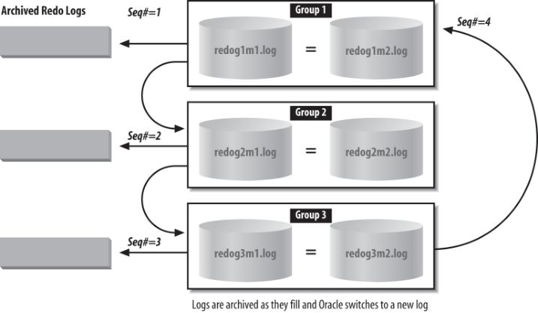
Archived Redo Logs

Slide 22
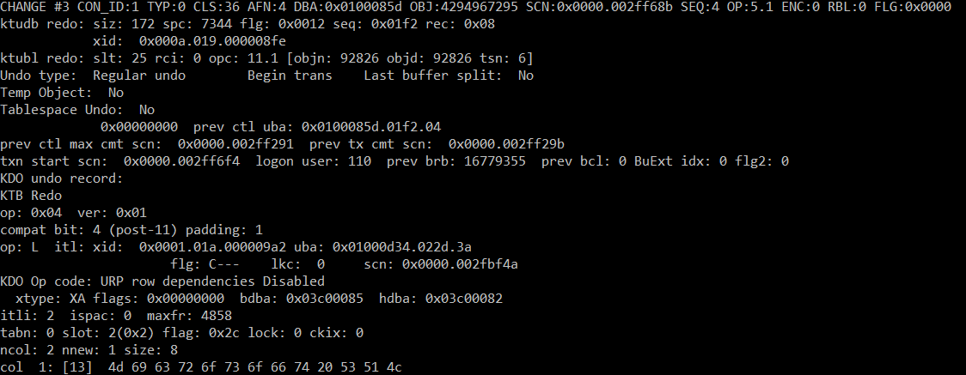
Redo Log Sample
alter system dump logfile '/u01/app/oracle/oradata/orcl/redo03.log';

Slide 23
Instance memory and processes

Slide 24
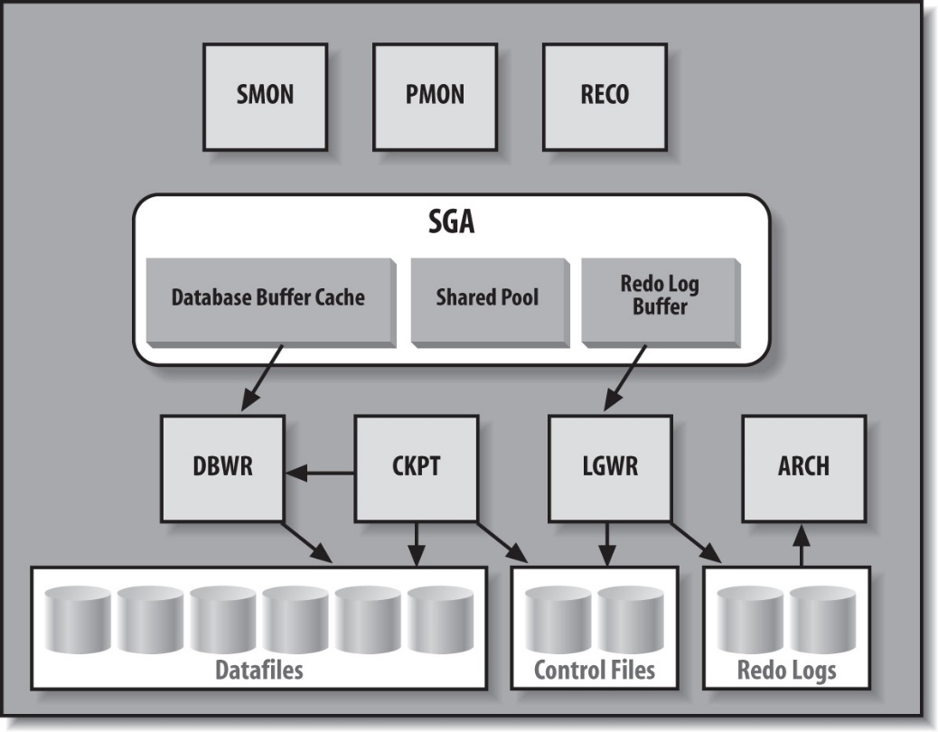
Main Oracle SGA Structures and Processes

Slide 25
Buffer Cache
The database buffer cache holds blocks of data retrieved from the database. This buffer between the users’ requests and the actual datafiles improves the performance of the Oracle Database.
If a piece of data can be found in the buffer cache (for example, as the result of a recent query), you can retrieve it from memory without the overhead of having to go to disk.
Oracle manages the cache using a least recently used (LRU) algorithm. If a user requests data that has been recently used, the data is more likely to be in the database buffer cache; data in the cache can be delivered immediately without a disk-read operation being executed.

Slide 26
Shared Pool
The shared pool contains two main components: the library cache, which is a cache of SQL statements, etc. and the dictionary cache, which caches Oracle own internal information, such as information about users and tables.
When we parse a query, the parsed representation is cached there. Before we go through the job of parsing an entire query, Oracle searches the shared pool to see if the work has already been done. PL/SQL code that you run is cached in the shared pool, so the next time you run it, Oracle doesn't have to read it in from disk again.

Slide 27
Redo Log Buffer
The redo log buffer caches redo information until it is written to the physical redo logfiles stored on a disk.
This buffer also improves performance (since a memory-to-memory transfer is much faster than a memory-to-disk transfer). Oracle caches the redo until it can be written to a disk at a more optimal time, which avoids the overhead of constantly writing the redo logs to disk.

Slide 28
Connecting to oracle

Slide 29
Server Processes and Clients
To access a database, a user connects to the instance that provides access to the desired database. A program that accesses a database is really composed of two distinct pieces — a client program and a server process—that connect to the Oracle instance. For example, running the SQL*Plus involves two processes:
The SQL*Plus process itself, acting as the client
The Oracle server process, sometimes referred to as a shadow process, that provides the connection to the Oracle instance

Slide 30
Connecting to Oracle: Dedicated Server
Notes:
1. The client contacts the Listener over the network.
2. The Listener detects an incoming request and introduces the requesting client to an Oracle server process.
3. The Listener introduces the server to the client by letting each know the other’s network address.
4. The Listener steps out of the way and lets the client and server process communicate directly.

Slide 31
Connecting to Oracle: Shared Server
Notes:
1. The client contacts the Listener over the network.
2. The Listener detects an incoming request and, based on the Oracle Net configuration, determines that it is for a multithreaded server. Instead of handing the client off to a dedicated server, the Listener hands the client off to a dispatcher for the network protocol the client is using.
3. The Listener introduces the client and the dispatcher by letting each know the other’s network address.
4. Once the client and the dispatcher know where to find each other, they communicate directly. The Listener is no longer required. The client sends each work request directly to the dispatcher.
5. The dispatcher places the client’s request in the request queue in the SGA.
6. The next available shared server process reads the request from the request queue and does the work.
7. The shared server places the results for the client’s request in the response queue for the dispatcher that originally submitted the request.
8. The dispatcher reads the results from its queue.
9. The dispatcher sends the results to the client.

Slide 32
SQL Execution

Slide 33
Executing
Notes:
1. The user modifies the employee name on-screen and the client application sends a SQL UPDATE statement over the network to the server process.
2. The server process looks for an identical statement in the shared SQL area of the shared pool. If it finds one, it reuses it. Otherwise, it checks the statement for syntax and evaluates it to determine the best way to execute it. This processing of the SQL statement is called parsing and optimizing. Once the processing is done, the statement is cached in the shared SQL area.
3. The server process copies the old image of the employee data about to be changed notes the changes in a rollback segment and to a redo segment. The rollback segment changes are part of the redo. This may seem a bit odd, but remember that redo is generated for all changes resulting from the transaction. The contents of the rollback segment have changed because the old employee data was written to the rollback segment for undo purposes. This change to the contents of the rollback segment is part of the transaction and therefore part of the redo for that transaction.
4. Once the server process has completed this work, the process modifies the database block to change the employee name. The database block is stored in the database
cache at this time. Control is passed back to the client process.
5. The HR clerk commits the transaction.
6. The Log Writer (LGWR) process writes the redo information for the entire transaction from the redo log buffer to the current redo logfile on disk. When the operating
system confirms that the write to the redo logfile has successfully completed, the transaction is considered committed.
7. The server process sends a message to the client confirming the commit.

Slide 34
Oracle Database Architecture
Elias Nema
Lead Software Engineer
Elias_Nema@epam.com

